Slide 1


DEPARTMENT OF COMPUTER SCIENCE & ENGINEERING · UTTARA UNIVERSITY
Smart Courier and Parcel Management System
Design & Implementation — Real-Time Parcel Tracking Platform
PRESENTED BY
SUPERVISED BY
Sharmin Khatun
Tasnim Jahan Mim
Dr. Md. Obaidur Rahaman
Thesis Defense [July 2026]
ID: 2223081010
B.Sc. in CSE
ID: 2221081138
B.Sc. in CSE
Professor, Dept. of CSE
Notes:
Welcome the committee, introduce yourself and the thesis title.

Slide 2
PRESENTATION OUTLINE
What We'll Cover
01
Introduction & Background
02
Problem Statement
03
Research Objectives
04
Literature Review
05
Methodology
06
System Design
07
Implementation
08
Results & Analysis
09
Comparison & Discussion
10
Conclusion & Future Work
Department of CSE · Uttara University
02 / 16
Notes:
Walk through the outline in one breath, don't linger.

Slide 3
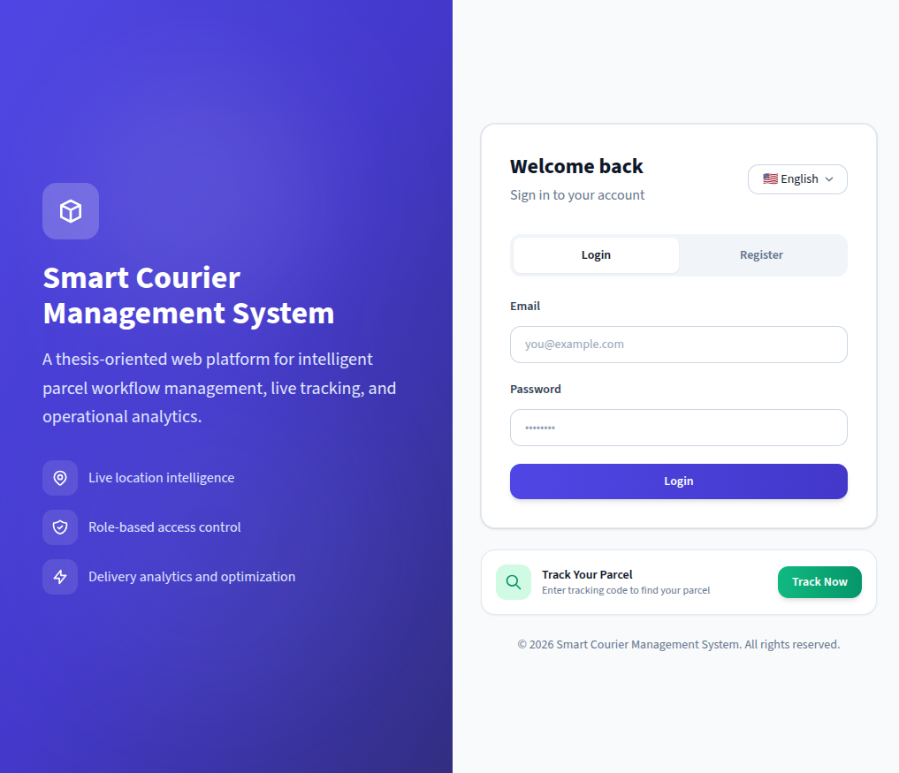
01 — INTRODUCTION
Introduction & Background
Manual coordination lacks real-time visibility
Static systems can't track dynamic deliveries
MERN platform: booking, tracking, QR, analytics
Department of CSE · Uttara University
03 / 16
Notes:
Set the context — why this domain matters before narrowing to the problem.

Slide 4
02 — PROBLEM STATEMENT
The Problem We Address
No real-time visibility into parcel status or location
WHO IS AFFECTED
CURRENT LIMITATION
WHY NOW
Customers, agents, and administrators
Fragmented tools, no live updates
E-commerce growth outpaces manual coordination
Department of CSE · Uttara University
04 / 16
Notes:
State the gap in one sentence, then the supporting points.

Slide 5
03 — OBJECTIVES
Research Objectives
01
02
Secure role-based access control (JWT)
Enforced six-state parcel lifecycle
03
04
Real-time tracking with QR verification
Operational analytics & report export
Department of CSE · Uttara University
05 / 16
Notes:
Each objective should map to a result you'll show later.

Slide 6
04 — LITERATURE REVIEW
Related Work
AUTHOR / YEAR
APPROACH
LIMITATION
Ahmed et al. (2019)
Web-based courier management system
Tracking not automated, delayed updates
Rahman et al. (2020)
Online parcel delivery & tracking
No real-time status monitoring
Khan et al. (2021)
Smart logistics management system
No agent route optimization
Pathao / Sundarban / Steadfast
Status-based consignment tracking
No live map or dashboard
Department of CSE · Uttara University
06 / 16
Notes:
Only show the 4-5 most relevant works; group by approach.

Slide 7
05 — METHODOLOGY
Research Methodology
1
2
3
4
Requirements Analysis
→
System Modeling
→
MERN Implementation
→
Testing & Metrics
Courier workflow study
ER, use case, sequence diagrams
REST API + Socket.IO
Functional + performance tests
Department of CSE · Uttara University
07 / 16
Notes:
Walk left to right through the pipeline.

Slide 8
06 — PROJECT TIMELINE
Project Timeline
Phase | Tasks | Duration
Planning | Literature Review & Gap Analysis | Weeks 1–2
Design | Database Schema & UI Wireframing | Weeks 3–4
Development | Backend API & Frontend Integration | Weeks 5–7
Testing | Bug Fixing & User Acceptance Testing | Weeks 7–9
Deployment | Final Hosting & Documentation | Weeks 9–12
Department of CSE · Uttara University
08 / 16

Slide 9
07 — SYSTEM DESIGN
System Architecture
React Frontend — Role-Based Dashboards
↓
Booking & Dispatch Engine
Real-Time Tracking Engine
Analytics & Reporting Engine
↓
MongoDB — Data & Storage Layer
Department of CSE · Uttara University
09 / 16
Notes:
Point to each layer/module as you name it.

Slide 10
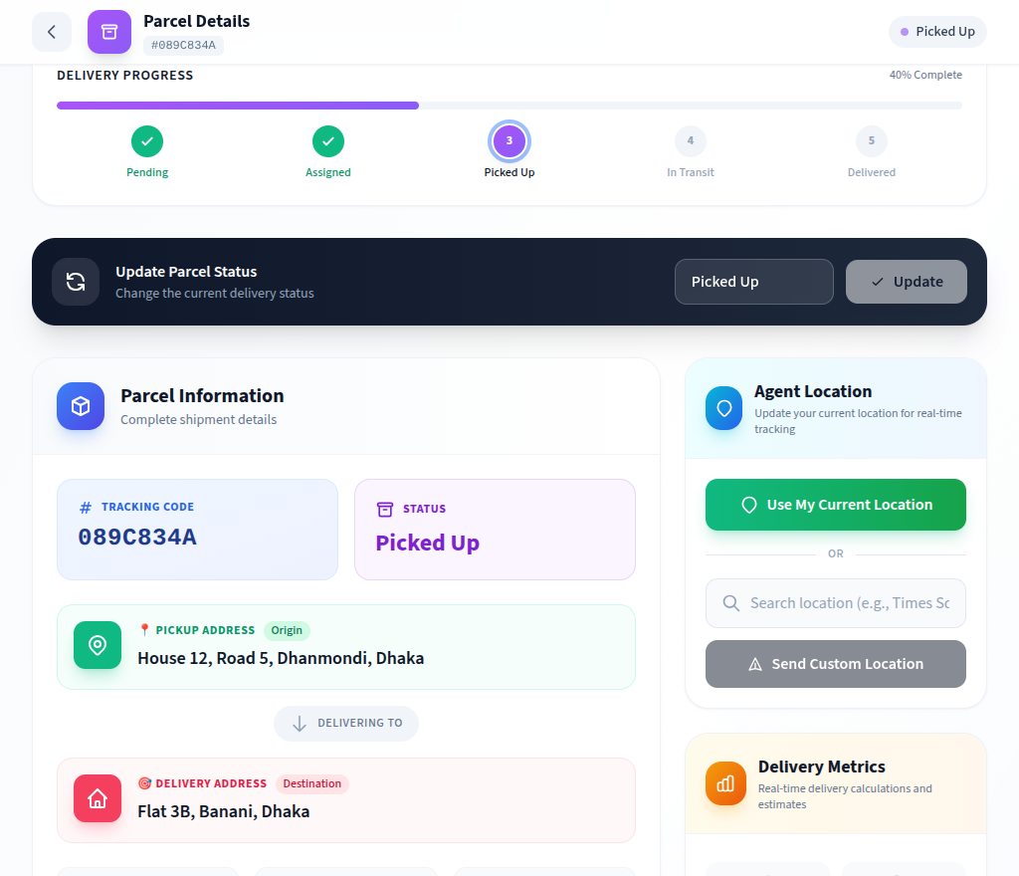
08 — IMPLEMENTATION
Implementation Details
TOOLS & TECHNOLOGIES
// Generate parcel tracking code
function createParcel(data) {
JavaScript
React + Express
Socket.IO
MongoDB
const code = uuid().slice(0,8);
return Parcel.create({ ...data, code });
Node.js
}
Short 8-char UUID-based codes — unique, unguessable, human-readable tracking IDs.
Department of CSE · Uttara University
10 / 16
Notes:
Mention only tools/decisions the committee will ask about.

Slide 11
09 — RESULTS & ANALYSIS
Results & Analysis
98.6%
0.96
180ms
Booking Success Rate*
Module Test Pass Ratio*
Avg. API Response Time*
*Estimated for demonstration
Department of CSE · Uttara University
11 / 16
Notes:
Lead with the headline number, then the chart.

Slide 12
10 — COMPARISON & DISCUSSION
How It Compares
METHOD
LIVE TRACKING
ROLE-BASED ACCESS
DELIVERY VERIFICATION
Sundarban Courier
Status-timeline only
No role dashboard
Signature only
Pathao / Steadfast
Status-timeline only
Merchant API only
Signature / OTP only
SCPMS (Proposed)
Live map tracking
Admin / Agent / Customer
QR scan-verified
Department of CSE · Uttara University
12 / 16
Notes:
Highlight the row/column where your approach wins.

Slide 13
11 — CONCLUSION & FUTURE WORK
Conclusion & Future Work
CONCLUSION
FUTURE WORK
Complete, working MERN courier platform
Redis-backed scaling for real-time layer
Solves real-time visibility gap directly
Delay prediction & traffic-aware routing
Live tracking + QR + analytics combined
SMS gateway & mobile agent app
Department of CSE · Uttara University
13 / 16
Notes:
Close the loop back to the objectives on slide 5.

Slide 14
12 — REFERENCES
References
[1] A. Ahmed, M. Rahman, S. Hossain, "Web-Based Courier Management System," IJCA, vol. 178, no. 7, pp. 25–30, 2019.
[2] M. Rahman, T. Islam, F. Ahmed, "Online Parcel Delivery and Tracking System," IJACSA, vol. 11, no. 5, pp. 412–418, 2020.
[3] S. Khan, A. Hasan, R. Uddin, "Smart Logistics Management System Using Web Technologies," JCSIT, vol. 9, no. 2, pp. 55–62, 2021.
[4] D. Jones, M. Bradley, N. Sakimura, "JSON Web Token (JWT)," RFC 7519, IETF, 2015.
[5] Socket.IO, "Socket.IO Documentation (v4)." [Online]. socket.io/docs/v4
[6] V. Agafonkin, "Leaflet: Open-Source JS Library for Maps"; OpenStreetMap Contributors. [Online]. leafletjs.com
Department of CSE · Uttara University
14 / 16
Notes:
No need to read these aloud — keep for committee reference.

Slide 15
13 — ACKNOWLEDGEMENT
Acknowledgement
Thanks to Dr. Md. Obaidur Rahaman for guidance, the Department of CSE,
Uttara University, for its support.
Department of CSE · Uttara University
15 / 16
Notes:
Keep this brief and sincere.

Slide 16
Thank You
Questions & Discussion
Sharmin Khatun & Tasnim Jahan Mim ·
Notes:
Invite questions from the committee.

